Slide 1
Understanding a
Physics Solver
Eric Christensen
GTC 2009

Slide 2
What is a Rigid Body?
A non-deformable (ideal) representation of a solid object
Mass (linear m, angular I)
Velocity (linear v, angular w)
Collision Geometry

Slide 3
What is a Rigid Body?
Starts stationary and remains that way unless influenced by a force
Will remain in constant motion unless influenced by another force
Almost always under the influence of (accelerated by) gravity (in a game)

Slide 4
Collision Response
Contact constraint generated by intersection of Rigid Body and Geometry
Constraint consists of intersection normal, position, and depth
Move rigid body to positive side of plane
Ideally [v’ = v * normal + depth * normal]

Slide 5
Collision Response
v = -0.75
m = 1
radius = 0.5

Slide 6
Collision Response
v = -0.75
m = 1
radius = 0.5

Slide 7
Collision Response
New Constraint
Position
v = -0.75
m = 1
radius = 0.5

Slide 8
Collision Response
New Constraint
Position
v = -0.75
m = 1
radius = 0.5
Normal

Slide 9
Collision Response
New Constraint
Position
v = -0.75
m = 1
radius = 0.5
Normal
Depth

Slide 10
Collision Response
Simple Problem
Depth = 0.375
v’ = v * normal = 0
v’ = depth * normal
v = -0.75
m = 1
radius = 0.5

Slide 11
Collision Response
Simple Problem
Depth = 0.375
v’ = v * normal = 0
v’ = depth * normal
v = 0.375
m = 1
radius = 0.5

Slide 12
Collision Response
Same with two Rigid Bodies

Slide 13
Collision Response
Same with two Rigid Bodies

Slide 14
Collision Response
What if they have different mass?
2
0.5

Slide 15
Collision Response
square will have 4 times the “resistance to acceleration”
as the circle
if Constraint Force = F = 2
Circle Acceleration = ca = F / 0.5 = 4
Square Acceleration = sa = F / 2 = 1

Slide 16
Collision Response
square will have 4 times the “resistance to acceleration”
as the circle
if Constraint Force = F = 2
Circle Acceleration = ca = F / 0.5 = 4
Square Acceleration = sa = F / 2 = 1

Slide 17
Collision Response
One or Two Rigid Bodies
Easy to understand
Correct intersection functions most difficult
Good starting point
No need for a solver

Slide 18
Joints
Opposite collision constraints
Binds rigid bodies together
Binds rigid body to the world
Limits rotation about one or more axis

Slide 19
Joints
Ball Joint

Slide 20
Joints
Ball Joint
Consists of
Local offset to body A

Slide 21
Joints
Ball Joint
Consists of
Local offset to body A
Local offset
to body B

Slide 22
Joints
Ball Joint
When separated
a force is created that moves the bodies back together

Slide 23
Joints
Ball Joint
Square still has a mass of 2
Circle still has a mass of 0.5

Slide 24
What is a physics constraint?
Limits movement in a particular direction for one or two rigid bodies
A condition that a solution to an optimization problem must satisfy

Slide 25
What is a physics constraint?
Set of linear and angular components that describe a restriction on velocity
The output is generally referred to as Jacobian data
Removes one degree of freedom

Slide 26
What is Jacobian Data?
Linear vector
Angular vector
Constraint force
Upper and Lower boundaries
Mixing Coefficient

Slide 27
How is the data used?
Velocities are projected onto the linear and angular vectors
The magnitudes are limited and force is added in the direction of the vectors
Corrects error between one or two rigid bodies

Slide 28
Why use a solver?
When number of interacting rigid bodies is high
Constrained rigid bodies in a pool are dependent on each other
Prevent catch-22 symptoms
Stability

Slide 29
Why use a solver?
Moving one rigid body requires moving all neighbor rigid bodies
System requires “simultaneous” solution
Special quadratic programming problem called Linear Complementarity

Slide 30
Benefits?
We can use this solver for as many constraints as we want
The more we iterate, the more accurate the solution is
Solution is mostly smooth
Can solve any type of constraint without modification

Slide 31
Limited to physics?
No
Fitting an internally constrained lattice to a height field
Calculating optimal steering for a navigation group
Fluid dynamics
Any other system of dependant variables that have rules

Slide 32
What is Jacobian Data
Describes constraint along an axis
Defines some rules about how to solve
Most important piece of data when building a solution

Slide 33
Building Jacobian Data
Linear Vector (constrains translation)
Angular Vector (constrains rotation)
Bounds (limits)
Mix coefficient
Constraint Force (error magnitude)

Slide 34
Building Jacobian Data
Linear Component
(Collision Normal)

Slide 35
Building Jacobian Data
Angular Component
(Center Mass –
Intersection Point) cross
(Collision Normal)

Slide 36
Building Jacobian Data
Bounds
Negative: 0
Positive: INF

Slide 37
Bounds (Limits)
Defines which direction we can travel along component vectors
Upper = INF, object allowed to move in the direction of normal by constraint force
Lower = 0, object not allowed to move in the opposite direction of normal

Slide 38
Building Jacobian Data
Constraint Force
(intersection depth)

Slide 39
Mixing Coefficient
Allows constraint to “give way” to other constraints in the solution
One way to soften the solution
Can also scale down constraint force
Good way to reduce jitter, if any

Slide 40
Preconditioning the Solver
Ax=b
Want to find x to satisfy b
A bit more complicated because A[0]x[0]=b[0] is dependent on A[1]x[1]=b[0]

Slide 41
Setting up b for one rigid body
Sum of velocity projections onto Jacobian Components
u = Linear Velocity * Linear Jacobian Vector
v = Angular Velocity * Angular Jacobian Vector
b = u + v
b’ = constraint force – b
Tells us what our velocity must be to move to positive side

Slide 42
Mixing and Using Mass
b is modified based on rigid body mass
Reduces or Augments b for rigid body relative movement
Heavier rigid body will move less than lighter rigid body

Slide 43
How?
Create a value that scales our desired target velocity
First need to multiply jacobian vectors by inverse mass and sum them
We’ll call it JM^T
JM^-1 = jacobian linear * mass^-1 + jacobian angular * Inertia Tensor^-1

Slide 44
How?
Project for our scaling component
We’ll call it D
We’re actually constructing the diagonal component of A from Ax=b
D = JM^-1 * jacobian linear + JM^-1 * jacobian angular
For a mass of 1, D should be 1
We also want to add the mixing coefficient

Slide 45
How?
D’ = D + Mixing Coefficient
We want to scale down so we get the reciprocal
D’ = 1 / D
If we wanted to mix, b should scale down
b’ = b * D
Our target velocity might have decreased by a small amount

Slide 46
How?
Jacobian vectors now must be scaled by D
This is because we want them to reflect our mass while projecting in the solver
We must also scale D by our mixing coeff
This tells the solver to “lie” about our delta thus “mixing”
D’ = D * mixing coefficient

Slide 47
Now What?
We now have our mass scaled linear and angular jacobian vectors
D, our “A” diagonal
b, our right hand side
It’s time to solve our problem

Slide 48
Solving the problem
Some extra vectors to deal with
L, our lambda
Tells us how much we’ve “moved” in total, relative to our jacobian vectors
d, our delta
Tells us how much we’ve moved in a single iteration
x, resulting force

Slide 49
Solving the Problem
Loop over each constraint
“d” has an initial value
d = b – L * D
If D = 0, we don’t mix, so lamda has no residual effect
In this simple case, “d” is our desired movement (which satisfies “b”)

Slide 50
Solving the Problem
“d” also reflects how much we have already moved
So we must subtract our projected velocity
d’ = d - velocity * jacobian linear
d’ = d - velocity * jacobian angular
“L” has accumulated how much we’ve moved
Remember jacobian vectors scaled by mass
We add “d” to “L” to test against bounds

Slide 51
Remembering Bounds
Lower and Upper “limits”
Tells us how we are allowed to move along jacobian vector
We limit “d” and set “L” to reflect our limit
L_test = d + L
if L_test < lower_bounds then d = lower_bounds – L, L = lower_bounds

Slide 52
Delta
We’ve modified delta
Multiply by JM^-1
Add to “x” (our resulting velocity)
When the solution is complete, “x” will be added to rigid body velocity

Slide 53
Wash, Rinse, Repeat
Each iteration brings us closer to a solution
The solution tells us the best answer that will satisfy our constraints
For large numbers of arbitrary constraints, solution will not be “perfect”
It will be close enough for good stability

Slide 54
How much to iterate?
Typically, for large systems, 10 to 20 iterations
Mileage may vary
Can I bail early?
Yes, in a perfect world “d” will reduce to 0
Track “d” and jump out when close to 0
Or some desired epsilon

Slide 55













A Simple 1D Example
Initial Velocity
Final Velocity
Jacobian Quantity
Jacobian Quantity Scaled by Diagonal
Right Hand Side
Constraint Force Mixing Coefficient
Constraint Force
Lower Bounds (Lower Limit)
Diagonal Conditioning Matrix (Pre-Scale)
Diagonal Conditioning Matrix (Scaled)
Lambda
Delta

Slide 56
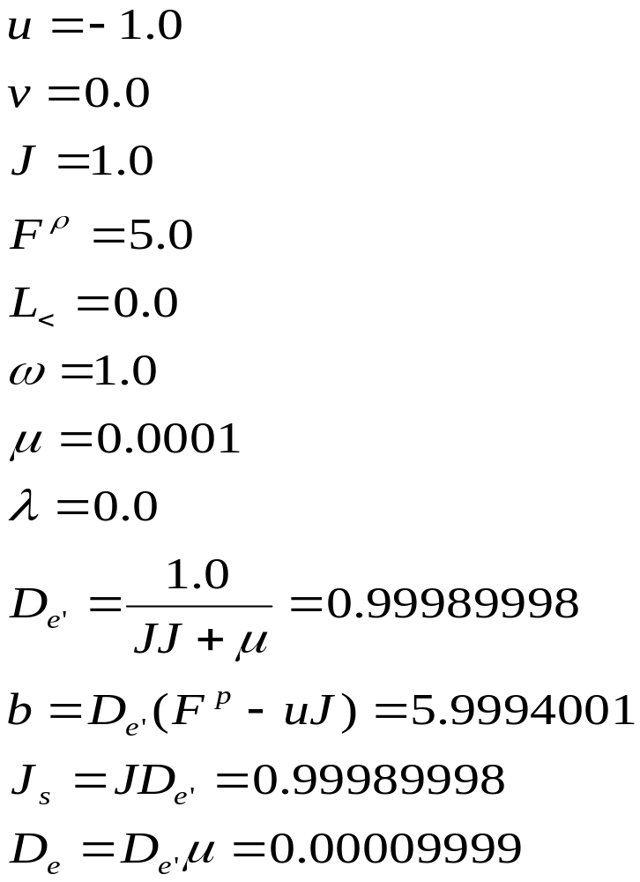
A Simple 1D Example

Slide 57
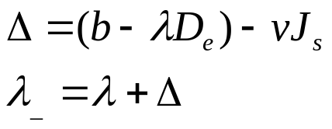







A Simple 1D example
if
then
and
else
One Iteration (converged)
Second Iteration (proof of convergence)

Slide 58
Closing
Try writing your own solver
It doesn’t matter if it is for physics
Think of problems that don’t have independent solutions
Example source code is provided on our website
Recommended Reading:
The Linear Complementarity Problem
By Richard W. Cottle, Jong-Shi Pang, and Richard E. Stone

Slide 59
Questions?

